Slide 1
Merchant Support Resolver
PAYTM BUILD FOR INDIA AI HACKATHON · CHENNAI · TRACK 3
An autonomous AI teammate that diagnoses and fixes merchant issues, so merchants stop waiting on tickets.
Team Fixr · Autonomous AI Teammates
Notes:
Introduce yourself in one line. The pitch in one sentence: an AI teammate for Paytm merchant support that resolves tickets end to end instead of only answering questions.

Slide 2
Merchants lose money and time waiting on support
PROBLEM STATEMENT
Settlement not received
QR or Soundbox down
Chargeback or dispute
Cash flow stalls while the merchant chases a UTR and a status nobody can see.
Every hour offline is lost sales and customers who pay in cash or walk away.
Unclear next steps and deadlines, so evidence is submitted late or not at all.
Each ticket today: explain, wait for a human to look up the data, then wait again for the fix.
Scale: Paytm’s merchant network spans 1.51 crore storefronts (Paytm, May 2026).
Notes:
Lead with a single merchant, for example a kirana owner in Chennai whose settlement is late. Support at this scale cannot stay manual. Keep to the three ticket types because the prototype will cover exactly these.

Slide 3
An AI teammate that resolves the ticket end to end
PROPOSED SOLUTION
Reads and remembers
Decides with guardrails
Takes action
Reads the message in Hindi, Tamil or English, pulls the merchant's data, and keeps the context of earlier turns.
One policy gate in code approves every read and every action, with limits on retries and tickets.
Re-triggers a settlement, raises a bank ticket, restarts a device, submits dispute proof, or hands the case to a human.
Replies in the merchant’s language: Hindi, Tamil and English. Voice is the next step.
Notes:
This is the Track 3 point: the agent does not only answer, it acts. Stress that humans stay in the loop for edge cases, and that every action is logged.

Slide 4
One ticket, four steps, no handoffs
PROPOSED SOLUTION · HOW IT WORKS
1
2
3
4
Understand
Diagnose
Act
Report
Reads the message and pulls merchant data, with earlier turns.
Finds the root cause using tools and rules.
Runs the fix inside policy limits, or escalates with a case file.
Tells the merchant what was done, in their own language.
Example
“Mera settlement nahi aaya” → settlement found, pending at the bank → bank ticket raised → merchant told in Hindi: expected credit tomorrow, 11 Nov.
Notes:
Walk through the example slowly. The demo on 15 November will show this exact flow, with the reasoning and action log visible on screen.

Slide 5
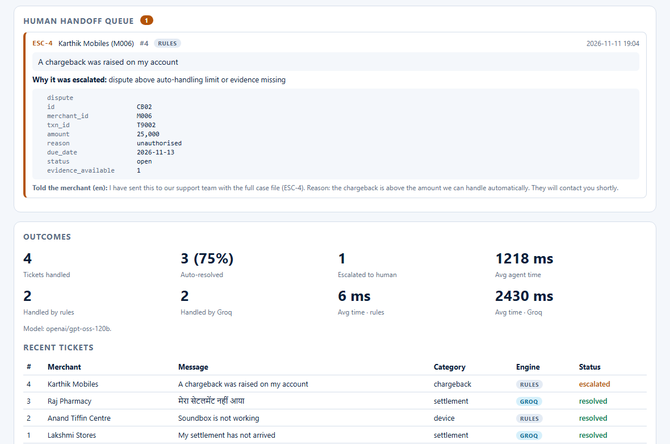
The whole loop, visible in one screen
LIVE DEMO
Human handoff queue
Every case the agent could not fix inside policy, with the case file and what the merchant was told.
Outcomes, measured
Tickets handled, auto-resolved, escalated, average time — and the rules-vs-Groq split on the same run.
Engine on every ticket
Which engine answered, which model, and whether it fell back. Two engines, one audit log.

Slide 6
Groq for reasoning, plain Python for safety
TECHNOLOGY STACK
Layer | Choice
Agent brain | Groq (groq.com) tool calling on openai/gpt-oss-120b, with a free rule-based fallback and automatic retry when the API rate-limits
Orchestration | Plain Python loop; every read and every action passes one policy gate in code
Data and tools | SQLite with synthetic data; 9 tools to investigate, act and escalate
Channels | Web chat in Hindi, Tamil and English; voice is a next step
Guardrails | One gate for reads and actions, action caps, human handoff, full audit log
Quality | 115 automated tests, CI on Python 3.9–3.13, and a 10-finding audit of the project closed to zero open
Built to plug into Paytm’s real settlement, device and ticketing APIs; the demo uses synthetic data.
Notes:
Emphasise there is no custom model training: the value is in the tools, policies and safety layer. Swapping the mock APIs for real internal APIs is the production path.

Slide 7
The model proposes. The code disposes.
SAFETY BY DESIGN
One checkpoint
Bounded by limits
No case left unhandled
policy_gate() in code is the only thing that can approve a read or an action.
At most 2 retriggers, 2 bank tickets and 2 restarts per record. A refused action escalates.
If the model only describes a case, the rule engine decides and a human still gets it.
Scoped to the merchant
merchant_id is injected in code, a cross-merchant read is refused, and every call is written to the audit log the support team reads.

Slide 8
Resolves, not just replies
UNIQUE SELLING PROPOSITION
Three differences a merchant notices in the first minute: the case closes itself, the reply arrives in their own language, and nothing happens outside policy.
Closes the loop
Speaks their language
Safe by design
Diagnoses the cause and executes the fix through tools, instead of pasting an FAQ link.
Replies in Hindi, Tamil and English, and remembers the conversation, so a follow-up does not start over.
Every read and every action passes one gate in code, with limits and a human handoff. Nothing outside policy happens.
Notes:
If judges ask how this differs from a chatbot: a chatbot answers, this agent changes system state and proves what it did through the audit log.

Slide 9
Faster fixes for merchants, fewer tickets for humans
IMPACT AND BENEFITS
Merchants
Paytm
Support team
Fixes in minutes, any hour, in their own language, with a clear next step.
Lower cost per ticket, better merchant retention and trust as the network grows.
Agents spend time on hard cases, with the diagnosis already done.
What we will measure
First-contact resolution · time to resolution · escalation rate · merchant satisfaction. Demo run: 4 tickets handled, 3 auto-resolved (75%), 1 escalated with a case file, 2 by Groq and 2 by rules, 0 fallbacks.
Notes:
Do not quote numbers you cannot defend. After the finals prototype runs, fill the bracket with the measured resolution rate and time across your test tickets.

Slide 10
Start with cost savings, grow into a merchant product
BUSINESS MODEL
Phase 1
Phase 2
Phase 3
Pilot
Merchant-facing
Expand
Resolve the top three ticket types inside Paytm’s support desk. Value: lower cost per ticket.
Offer the teammate inside the Paytm for Business app, with voice in regional languages.
Add proactive nudges and sales or lending follow-ups on the same agent platform.
Revenue levers: support cost saved, a premium priority-resolution tier for merchants, and higher retention.
Notes:
Be honest that Phase 1 is an internal efficiency play. The premium tier is a hypothesis to test in the pilot, not a promise. Close by restating the one-line pitch and offering the live demo.

